Slide 1

Blockchain
Sunitha R
Department of Computer Science and Engineering

Slide 2

Blockchain
Consensus Algorithms: PBFT
Sunitha R
Department of Computer Science and Engineering

Slide 3
Blockchain
Consensus Algorithm – Practical Byzantine Fault Tolerant
Lamport-Shostak-Pease Algorithm
Why Practical?
Ensures safety over an asynchronous network (not liveness!)
Byzantine Failure
Low overhead
Real Applications
Tendermint
IBM's Openchain
ErisDB
Hyperledger

Slide 4
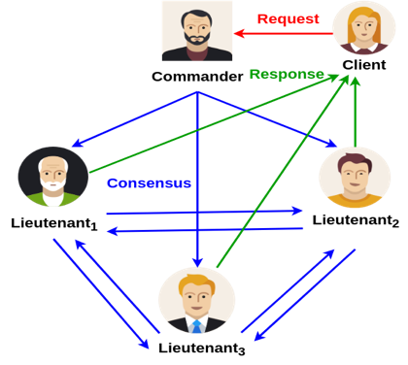
Blockchain
Consensus Algorithm – Practical Byzantine Fault Tolerant
Practical Byzantine Fault Tolerant Model
Asynchronous distributed system
delay, out of order message
Byzantine failure handling
arbitrary node behavior
Privacy
tamper-proof message, authentication

Slide 5
Blockchain
Consensus Algorithm – Practical Byzantine Fault Tolerant
Practical Byzantine Fault Tolerant Model
A state machine is replicated across different nodes
3𝑓 + 1 replicas are there where 𝑓 is the number of faulty replicas
The replicas move through a successions of configurations, known as
views
One replica in a view is primary and others are backups

Slide 6
Blockchain
Consensus Algorithm – Practical Byzantine Fault Tolerant
Practical Byzantine Fault Tolerant Model
Views are changed when a primary is detected as faulty
Every view is identified by a unique integer number 𝑣𝑣
Only the messages from the current views are accepted

Slide 7
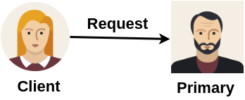
Blockchain
Consensus Algorithm – Practical Byzantine Fault Tolerant
A client sends a request to invoke a service operation to the primary
Courtesy: Castro, Miguel, and Barbara Liskov. "Practical Byzantine fault tolerance." OSDI. Vol. 99. 1999.

Slide 8
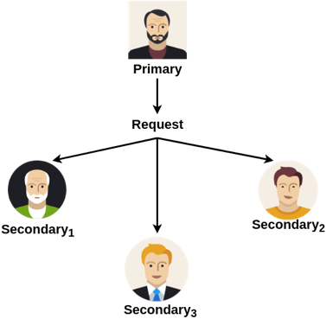
Blockchain
Consensus Algorithm – Practical Byzantine Fault Tolerant
The primary multicasts the request to the backups

Slide 9
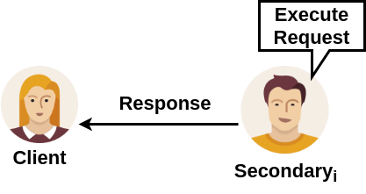
Blockchain
Consensus Algorithm – Practical Byzantine Fault Tolerant
Backups execute the request and send a reply to the client

Slide 10
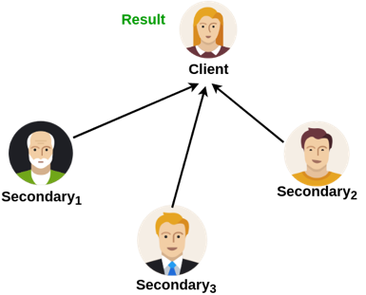
Blockchain
Consensus Algorithm – Practical Byzantine Fault Tolerant
The client waits for 𝑓 + 1 replies from different backups with the same result
– 𝑓 is the maximum number of faulty replicas that can be tolerated

Slide 11
Blockchain
Consensus Algorithm- Reference
Lamport, Leslie, Robert Shostak, and Marshall Pease. "The Byzantine generals problem." ACM Transactions on Programming Languages and Systems (TOPLAS) 4.3 (1982): 382-401.
Castro, Miguel, and Barbara Liskov. "Practical Byzantine fault tolerance." OSDI. Vol. 99. 1999.

Slide 12
THANK YOU
Sunitha R
Department of Computer Science and Engineering
sunithar@pes.edu

